Slide 1
Background and Motivation

Slide 2
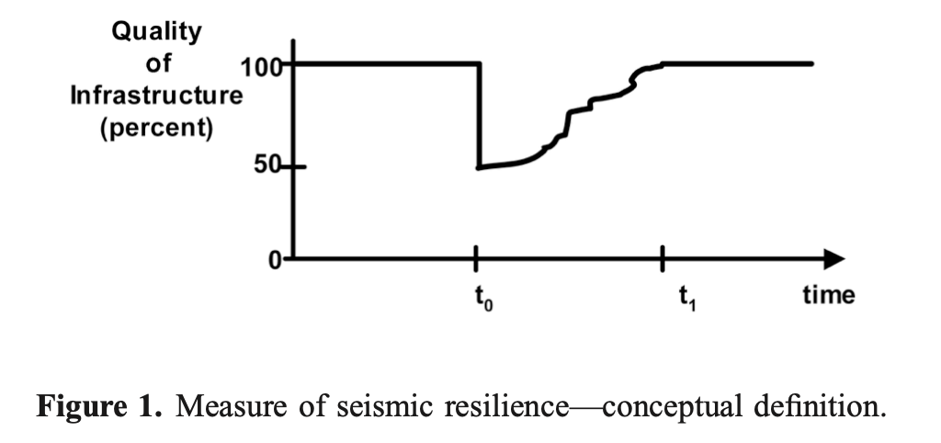
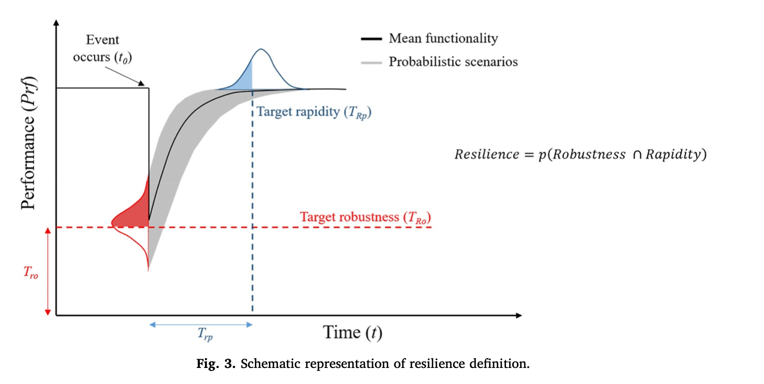
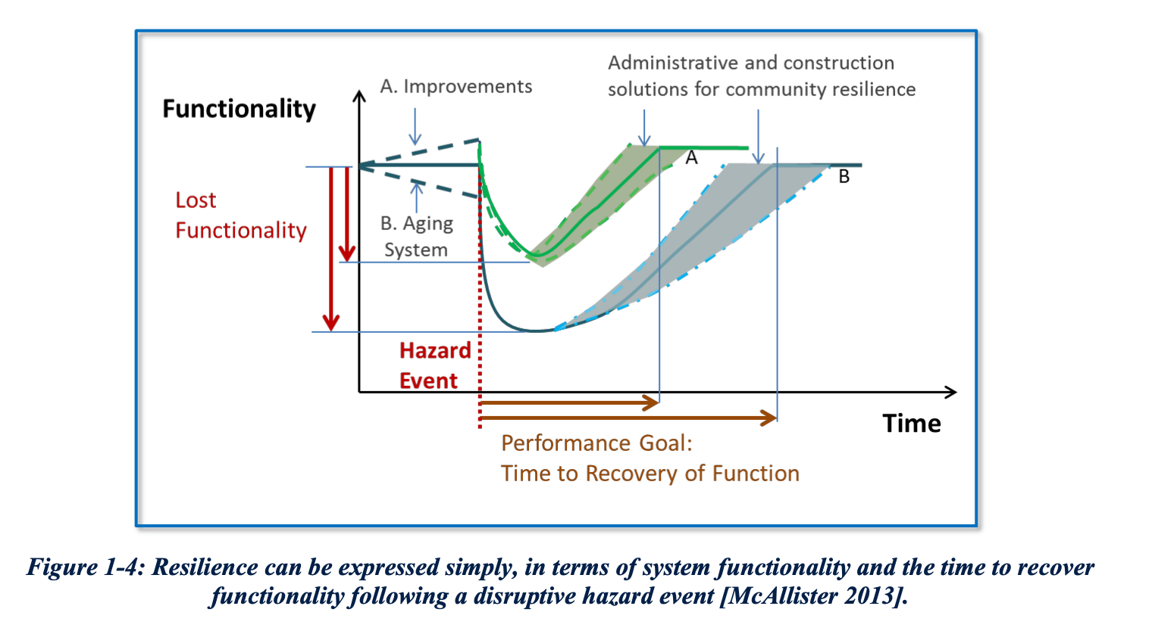
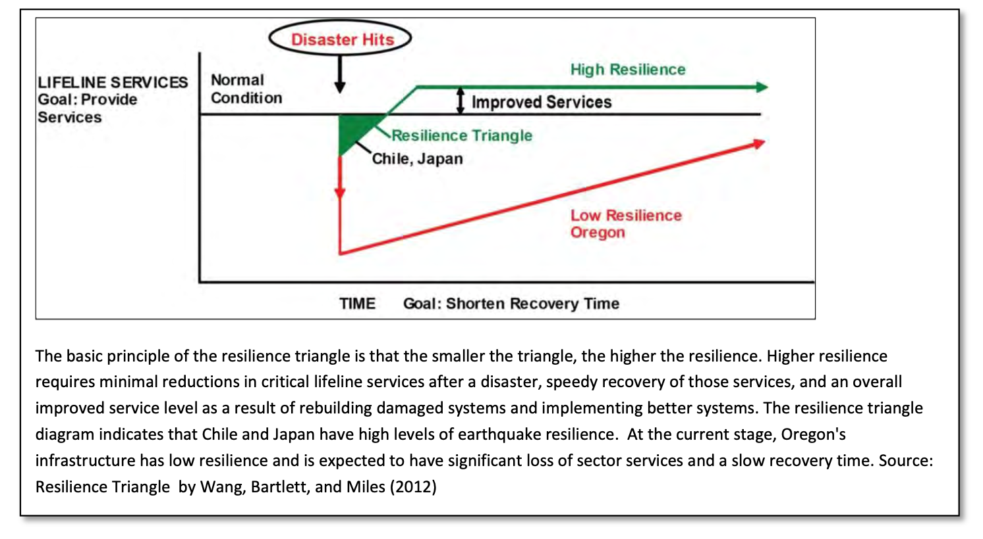
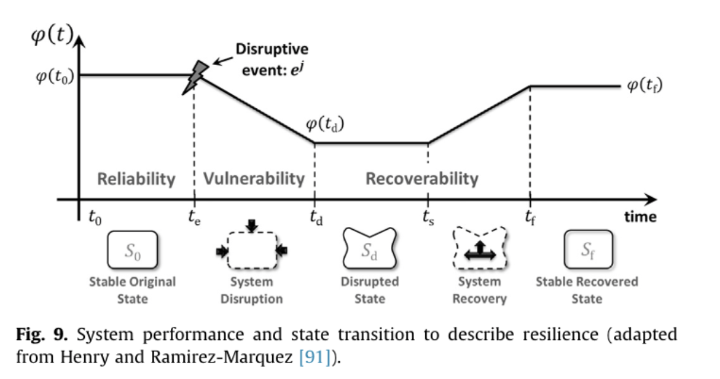
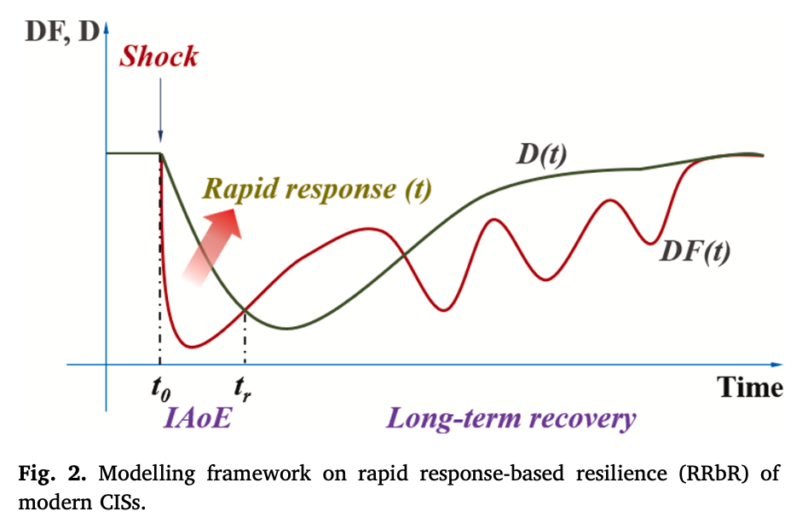
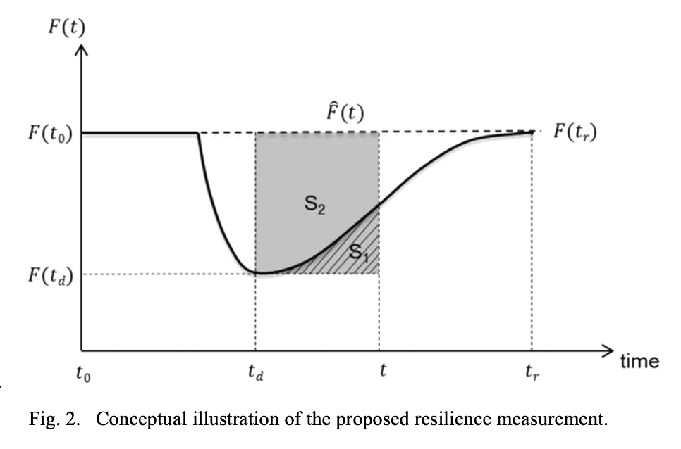
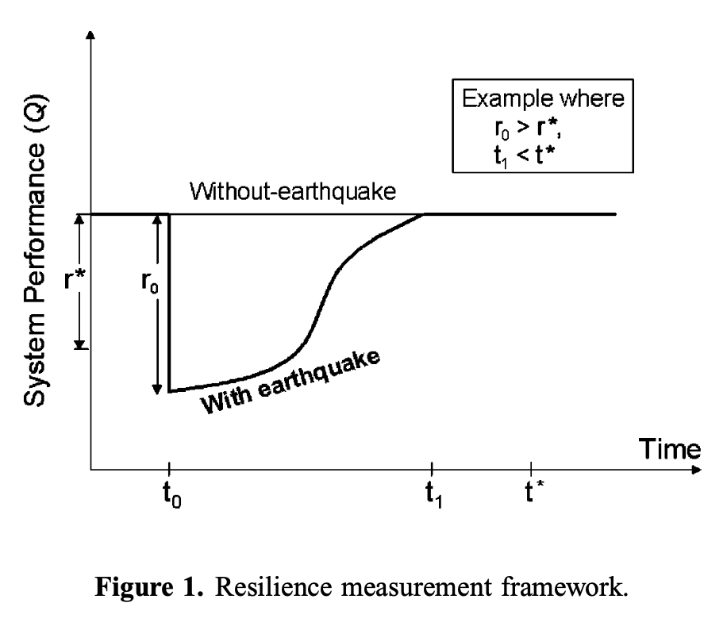
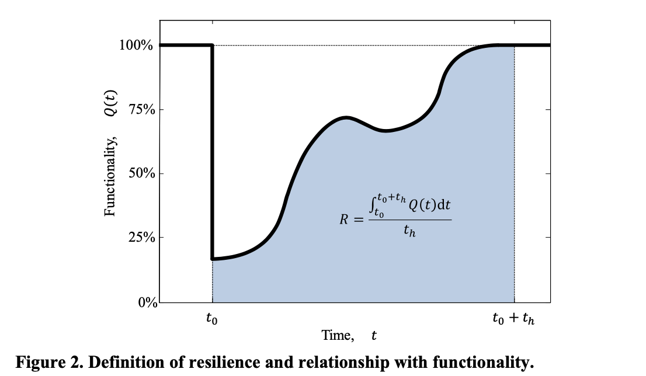
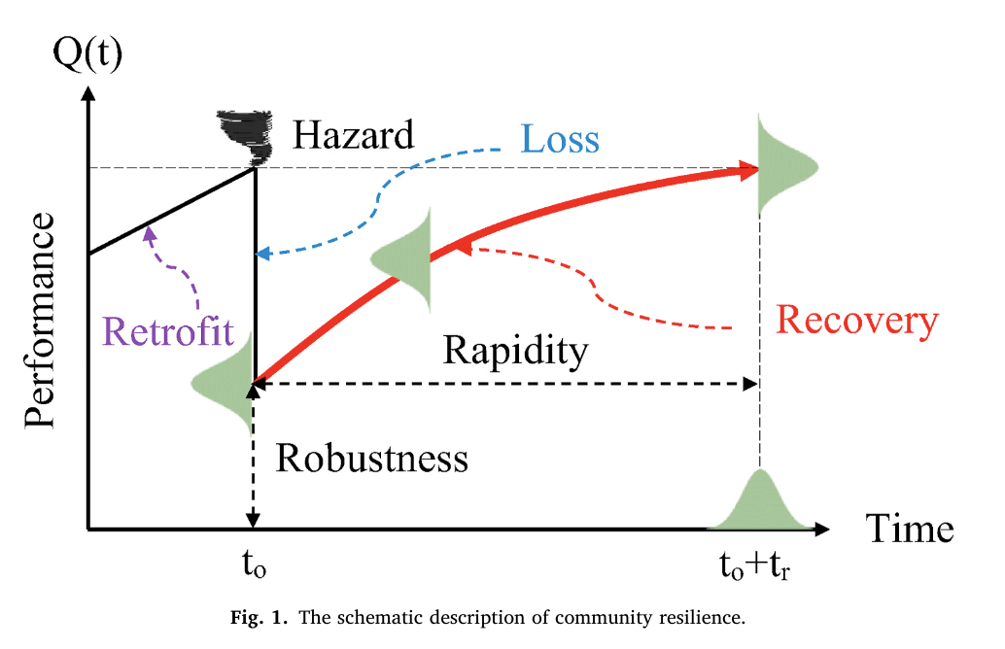
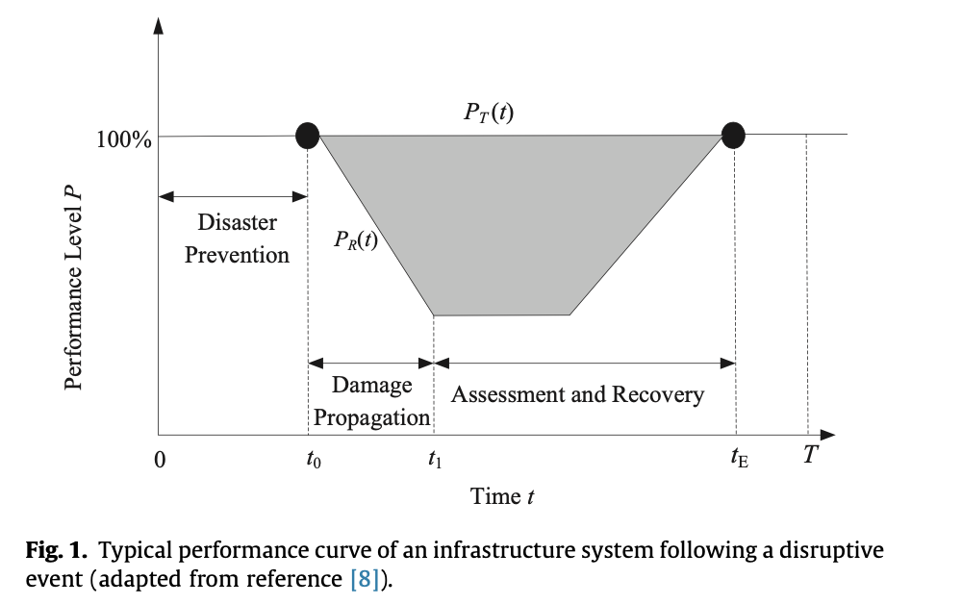
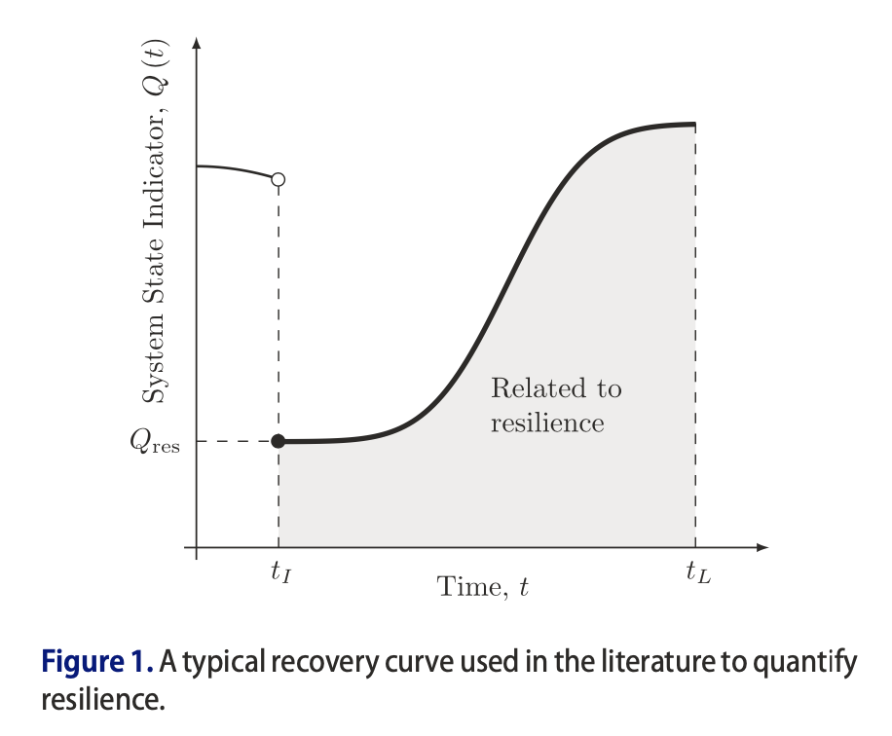
Motivation
Resilience often defined as two parts*:
Loss of system performance
Time to recover
Resilience often evaluated under present-day conditions
Some studies consider infrastructure deterioration
Want to consider what leads to resilient communities
What-if policy B was implemented rather than policy A?
Projections in future; use as a planning tool
Policy, land use planning, and changes to public infrastructure
Bruneau et al. (2003)
Kameshwar et al. (2019)
Some examples of resilience curves
NIST CRPG (2016)
Oregon Resilience Plan (2013)
Disturbance Occurs
Hosseini et al. (2016)
Sun et al. (2021)
Time to recover (repair time)
Fang et al. (2016)
Chang and Shinozuka (2004)
Loss of System Performance (functionality)
System Performance
Frangopol and Bocchini (2011)
Wang and van de Lindt (2021)
Time
*There are nuances in the definition of resilience. Some definitions have more than two parts (e.g., UNDRR Terminology on Disaster Risk Reduction)
Ouyang and Dueñas-Osorio (2014)
Sharma et al. (2018)

Slide 3

Motivation
Developing model with two parts:
Urban land use evolution model used to evaluate how different policy choices can lead to community changes over decades
IN-CORE is used to evaluate the damage & loss and risk avoidance after a given amount of time
Considering mitigation options on scale from household decisions to state & federal decisions
Disturbance Occurs
Policy A
Urban growth model
Status quo
Metric of interest
0 10 20 30 40
Present Day
Time (years)

Slide 4
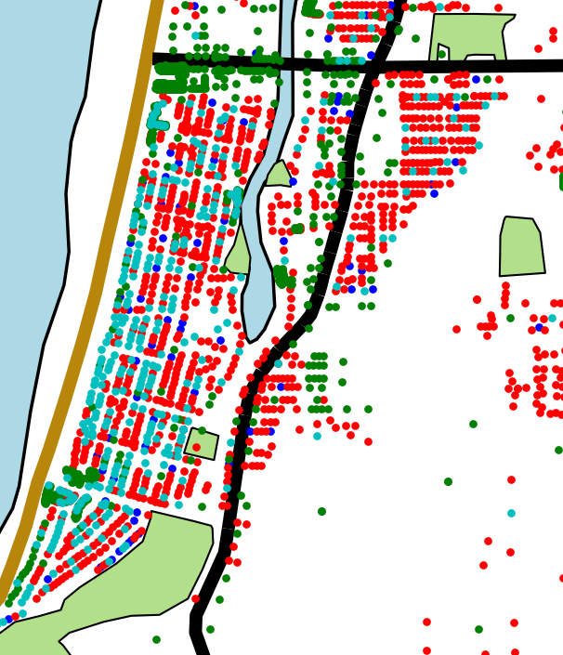


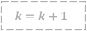
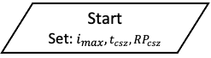
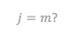
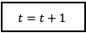
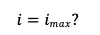
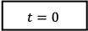

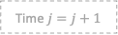
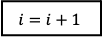
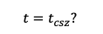

Flowchart
8b) Suite of policy levers and decision combinations
Property buyouts/Land Acquisition
Relocate public infrastructure
Retrofit public infrastructure
Establish building codes
City zoning regulations
Land use planning
No regulations
Start
Set:$i_{max}, t_{csz}, RP_{csz}$
$$t=0$$
8c) Economic, social, and physical infrastructure constraints
STOP – Adjust community goals/constraints
5a) Community Goals Based on Stability Metrics
Population Growth Model
8a) Optimization to select next PD for analysis from suite of n combinations
No
Yes
7a) Optimization Still Possible?
No
6a) Sufficient Quality Solutions Found?
Yes
No
Market Simulation
END
$$i=imax?$$
$$k=k+1$$
Yes
Time $j=j+1$
No
$j=m$?
Yes
2b) Damage Models
3a) Functionality Models
Urban landscape at time t
1) Current Community Description at time t
1a) Built Environment
1b) Social Systems
1c) Economic Systems
Record Quality Solutions
$$i=i+1$$
$$t=t_{csz}?$$
Yes
2c) Damage to physical Infrastructure
3b) Functionality of physical Infrastructure
4a) State of Recovery for community at time=$j$
No
2a) Hazard Models
3c) CGE Model
3d) Population Dislocation Model
END - Visualization
2d) Casualty
3e) Direct and Indirect Economic & Social Losses
Analysis $K$ complete
$$t=t+1$$

Slide 5
Model Status

Slide 6
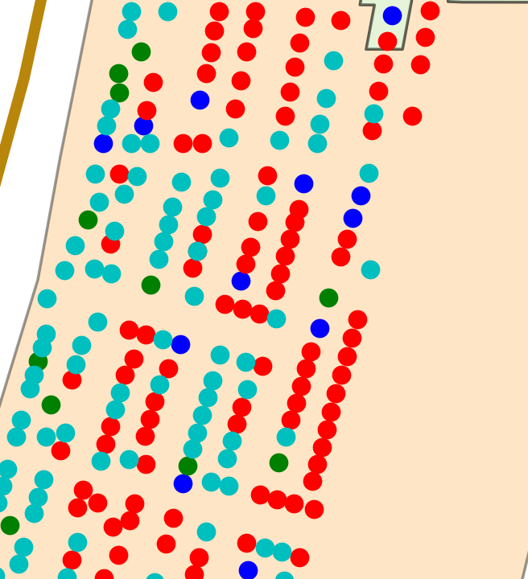
Current Status
Agents
Land uses
Unoccupied Owner
Unoccupied
Agents in market searching
Owned Residential
Household
Full time resident
Agent type 1
Agent type 2
Rental Residential
Landlord
Agents associated with parcels
Low Occupancy Seasonal Rental
Company
High Occupancy Residential
Visitor
High Occupancy Seasonal Rental
Environment/Parcel Space
Commercial
*Arrows denote agent occupies parcel
**Colors denote agent owns parcel

Slide 7
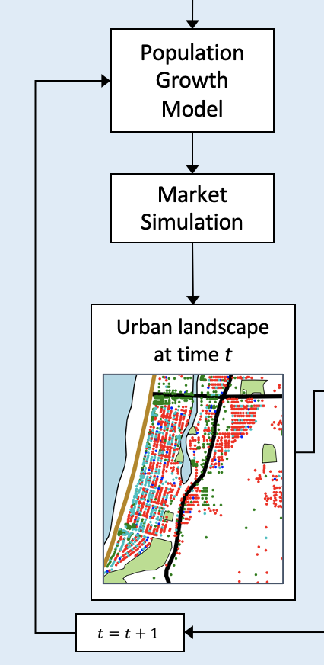
Market Simulation
Agents
Land uses
Market Scheduling (Filatova et al., 2011):
Available parcels are listed on market by owners wanting to sell
Agents not assigned to a parcel search market for parcels that meet preferences
Agents formulate bid and submit to seller of parcel
Sellers evaluate received bids
Transaction and registration of trade
Unoccupied Owner
Unoccupied
Household
Full time resident
Owned Residential
Rental Residential
Landlord
Low Occupancy Seasonal Rental
Company
High Occupancy Residential
Visitor
High Occupancy Seasonal Rental
Commercial
*Arrows denote agent occupies parcel
**Colors denote agent owns parcel

Slide 8
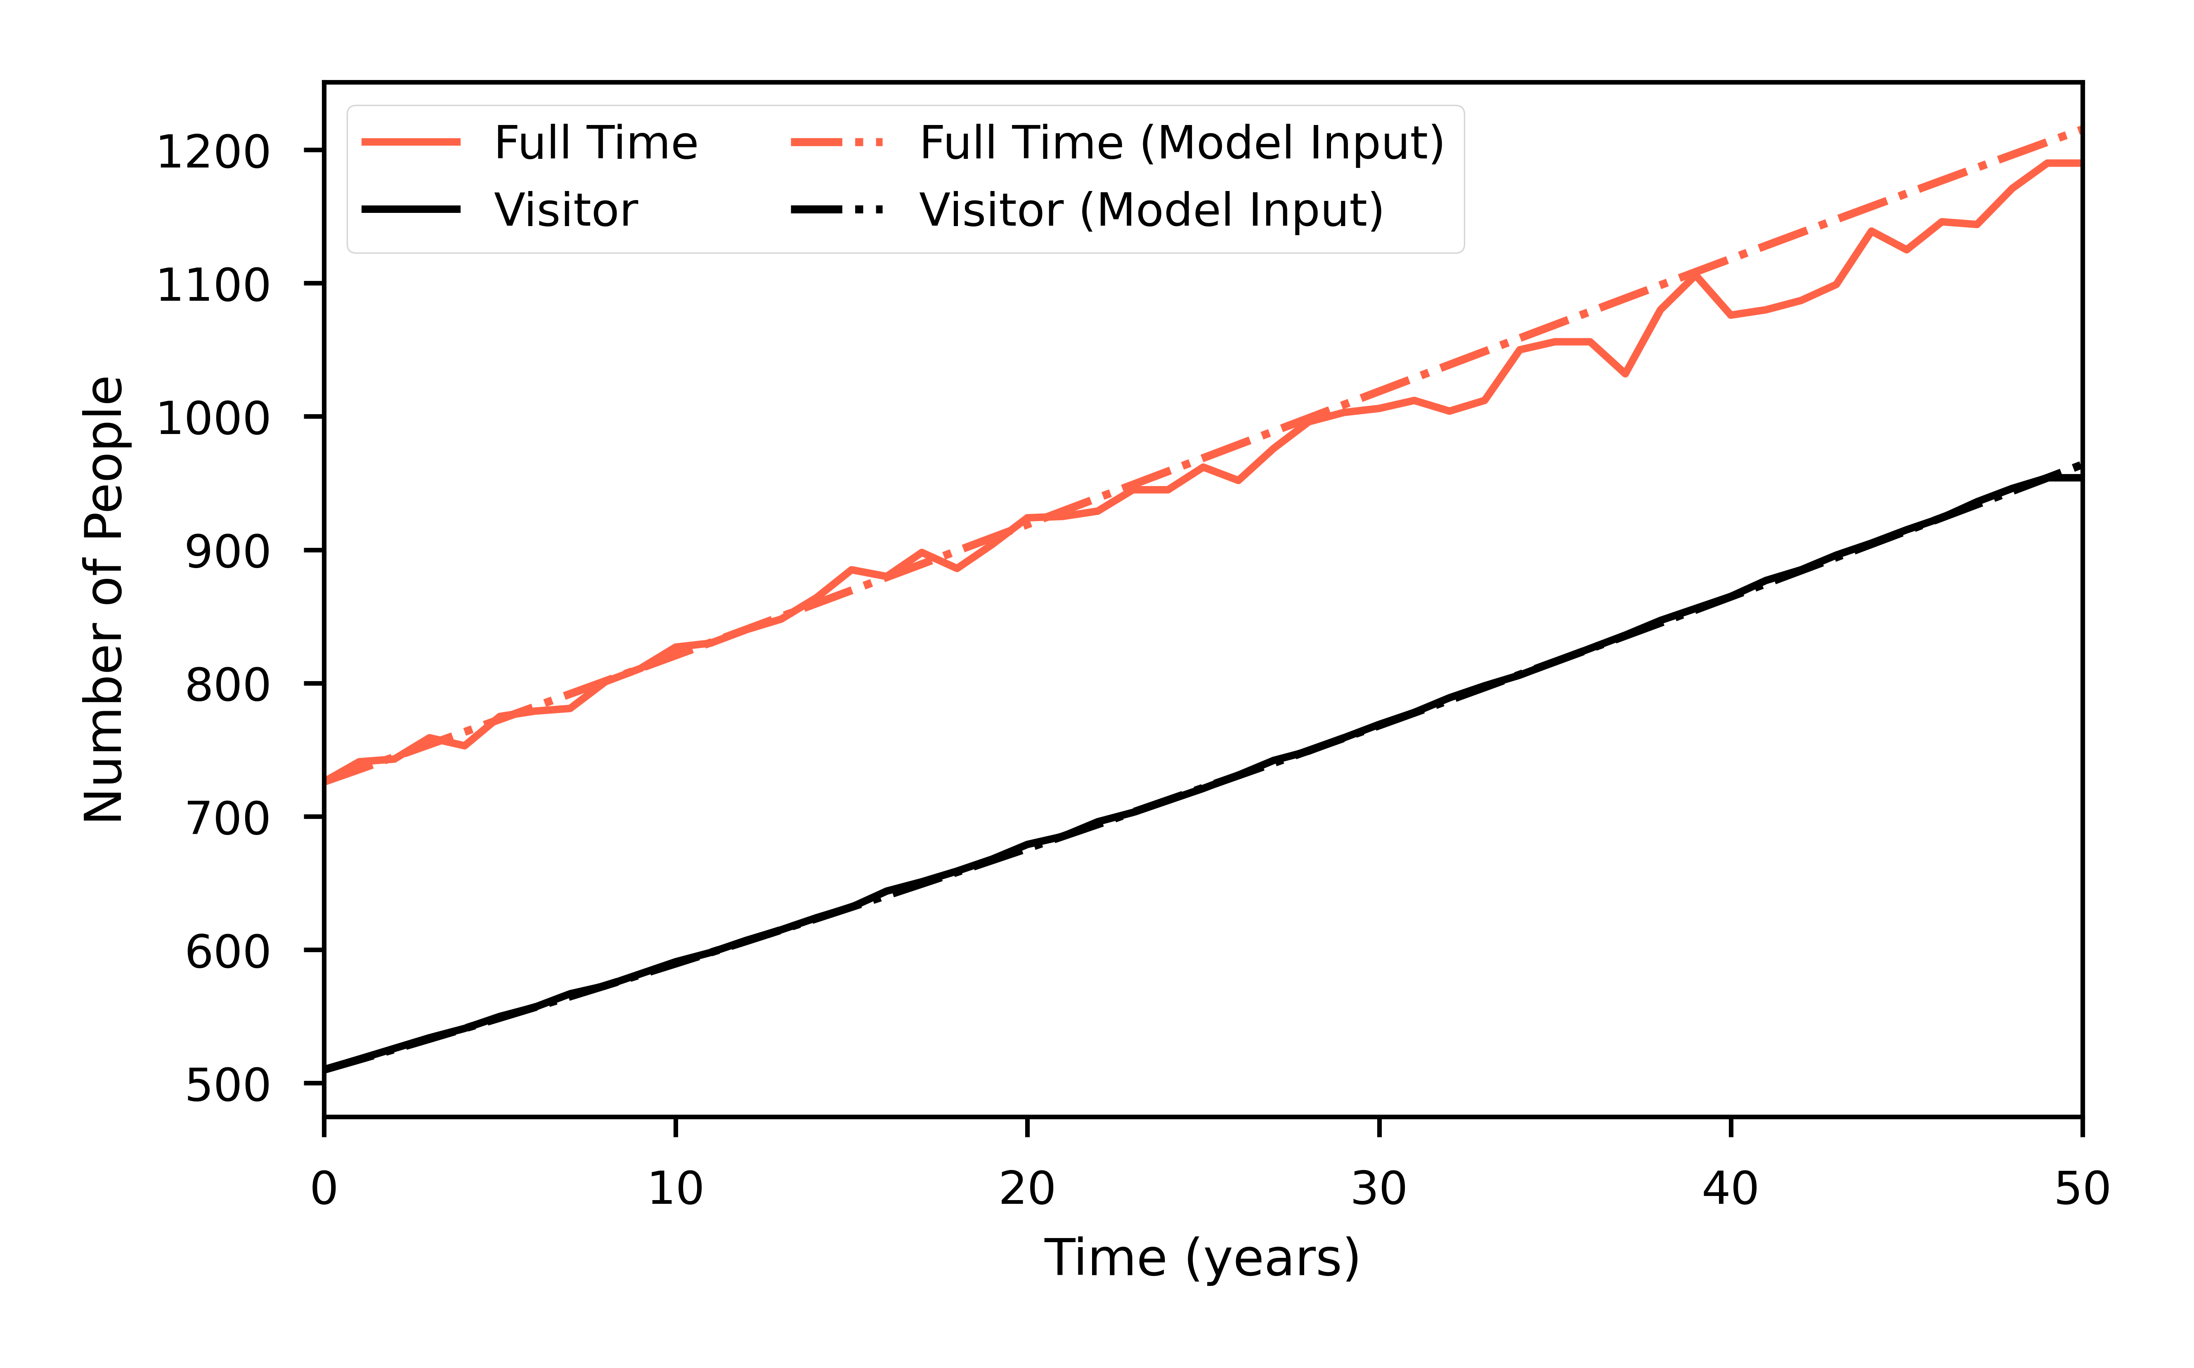
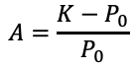
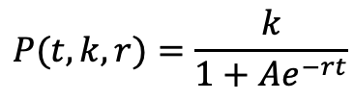
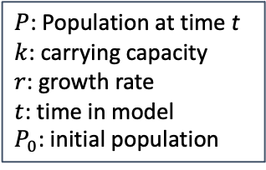
Population Growth
Add citations
Potentially consider another growth function
Agents
Land uses
Household and visitor agent population growth is input to model
Logistic population growth
Unoccupied Owner
Unoccupied
$$P(t, k, r)=\frac{k}{1+Ae^{−rt}}$$
Household
Full time resident
Owned Residential
$P$: Population at time t
$k$: carrying capacity
$r$: growth rate
$t$: time in model
$P_{0}$: initial population
$$A=\frac{K−P_{0}}{P_{0}}$$
Rental Residential
Landlord
Low Occupancy Seasonal Rental
Company
High Occupancy Residential
Visitor
High Occupancy Seasonal Rental
Commercial
*Arrows denote agent occupies parcel
**Colors denote agent owns parcel

Slide 9
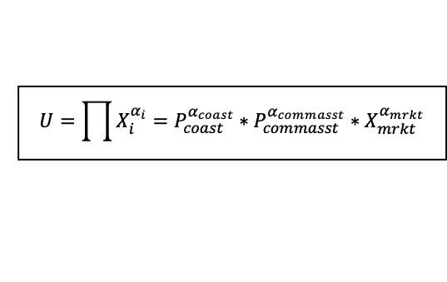
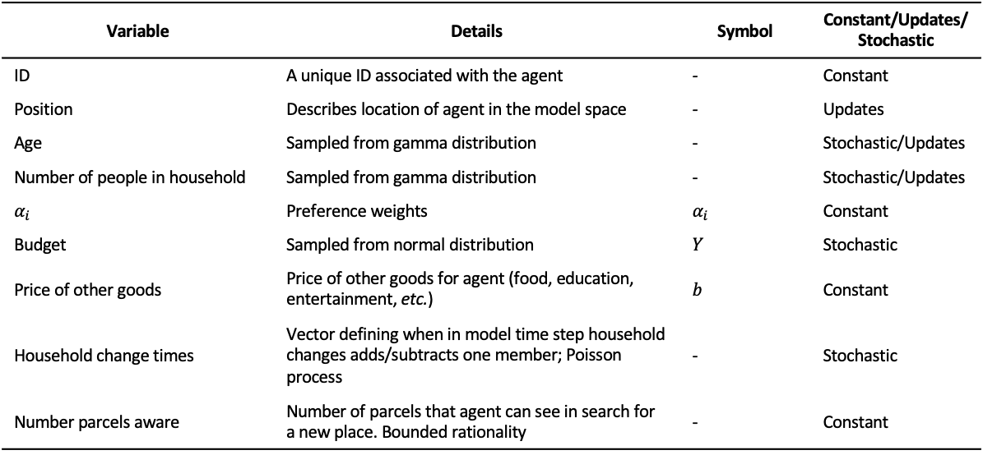
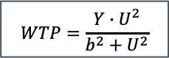
Household Agent
Searching for place to reside
Bids on parcel that maximizes utility (Filatova et al., 2011; Parker et al., 2012)
No distinction between owning and renting property
Can occupy: owned residential, rental residential, high occupancy residential
Age: initially random, updated at each time step, agent is removed at age 80
Number of people: initially random, +/- 1 person with Poisson process
Agents
Land uses
Unoccupied Owner
Unoccupied
Household
Full time resident
Owned Residential
Variable | Details | Symbol | Constant/Updates/Stochastic
ID | A unique ID associated with the agent | - | Constant
Position | Describes location of agent in the model space | - | Updates
Age | Sampled from gamma distribution | - | Stochastic/Updates
Number of people in household | Sampled from gamma distribution | - | Stochastic/Updates
$$α_{i}$$ | Preference weights | $$α_{i}$$ | Constant
Budget | Sampled from normal distribution | $$Y$$ | Stochastic
Price of other goods | Price of other goods for agent (food, education, entertainment, etc.) | $$b$$ | Constant
Household change times | Vector defining when in model time step household changes adds/subtracts one member; Poisson process | - | Stochastic
Number parcels aware | Number of parcels that agent can see in search for a new place. Bounded rationality | - | Constant
Rental Residential
Landlord
Low Occupancy Seasonal Rental
Company
High Occupancy Residential
Visitor
High Occupancy Seasonal Rental
Commercial
Cobb-Douglas utility function: commonly used in urban economics (Huang et al., 2014)
*Arrows denote agent occupies parcel
**Colors denote agent owns parcel
$$U=\prod{X_{i}^{α_{i}}}=P_{coast}^{α_{coast}}∗P_{commasst}^{α_{commasst}}∗X_{mrkt}^{α_{mrkt}}$$
$$WTP=\frac{Y∙U^{2}}{b^{2}+U^{2}}$$
Filatova et al. (2011)

Slide 10
Visitor Agent
Agents
Land uses
Visitor agent: household, group of friends, etc., visiting model space
Multiple people are associated with a single visitor agent
At each model time step:
All visitor agents from previous time step are removed
Update number of visitor agents to meet visitor population at time step t
Randomly assign visitors to either low occupancy seasonal rental (LOSR) or high occupancy seasonal rental (HOSR)
Primary factor influencing market performance (e.g., HOSR vs. LOSR) is demand level or number of visitors (Bruno and Faggini, 2020)
Secondary factors include price setting and competition between markets
Unoccupied Owner
Unoccupied
Household
Full time resident
Owned Residential
Rental Residential
Landlord
Low Occupancy Seasonal Rental
Company
High Occupancy Residential
Variable | Details | Symbol | Constant/Updates/Stochastic
ID | A unique ID associated with the agent | - | Constant
Position | Describes location of agent in the model space | - | Updates
Number of people in household | Sampled from gamma distribution | - | Stochastic
Visitor
High Occupancy Seasonal Rental
Commercial
*Arrows denote agent occupies parcel
**Colors denote agent owns parcel

Slide 11
Unoccupied Owner Agent
Agents
Land uses
Agent associated with unoccupied parcels
Takes over parcel if any other agent leaves
Puts parcels on market
Sets willingness to accept price (Parker and Filatova, 2008)
Enters negotiation with bidders
Unoccupied Owner
Unoccupied
Household
Full time resident
Owned Residential
Rental Residential
Variable | Details | Symbol | Constant/Updates/Stochastic
ID | A unique ID associated with the agent | - | Constant
Position | Describes location of agent in the model space | - | Updates
Willingness to accept | Minimum price that agent will take from bidders | WTA | Constant
Landlord
Low Occupancy Seasonal Rental
Company
High Occupancy Residential
Visitor
High Occupancy Seasonal Rental
Commercial
*Arrows denote agent occupies parcel
**Colors denote agent owns parcel

Slide 12
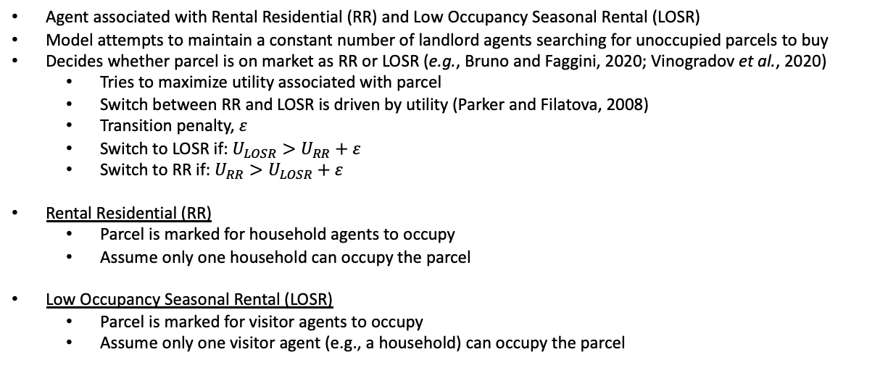
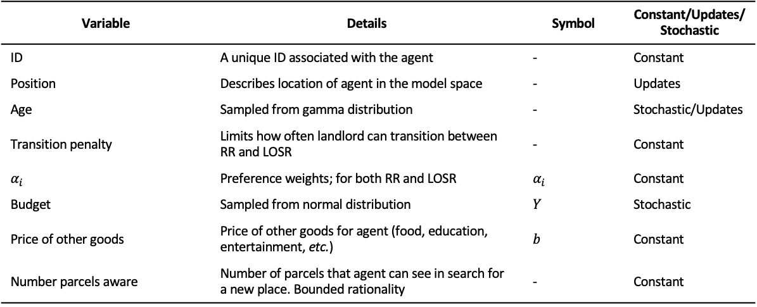
Landlord Agent
Agent associated with Rental Residential (RR) and Low Occupancy Seasonal Rental (LOSR)
Model attempts to maintain a constant number of landlord agents searching for unoccupied parcels to buy
Decides whether parcel is on market as RR or LOSR (e.g., Bruno and Faggini, 2020; Vinogradov et al., 2020)
Tries to maximize utility associated with parcel
Switch between RR and LOSR is driven by utility (Parker and Filatova, 2008)
Transition penalty, $ε$
Switch to LOSR if: $U_{LOSR}>U_{RR}+ε$
Switch to RR if: $U_{RR}>U_{LOSR}+ε$
Rental Residential (RR)
Parcel is marked for household agents to occupy
Assume only one household can occupy the parcel
Low Occupancy Seasonal Rental (LOSR)
Parcel is marked for visitor agents to occupy
Assume only one visitor agent (e.g., a household) can occupy the parcel
Agents
Land uses
Unoccupied Owner
Unoccupied
Household
Full time resident
Owned Residential
Rental Residential
Landlord
Low Occupancy Seasonal Rental
Company
Variable | Details | Symbol | Constant/Updates/Stochastic
ID | A unique ID associated with the agent | - | Constant
Position | Describes location of agent in the model space | - | Updates
Age | Sampled from gamma distribution | - | Stochastic/Updates
Transition penalty | Limits how often landlord can transition between RR and LOSR | - | Constant
$$α_{i}$$ | Preference weights; for both RR and LOSR | $$α_{i}$$ | Constant
Budget | Sampled from normal distribution | $$Y$$ | Stochastic
Price of other goods | Price of other goods for agent (food, education, entertainment, etc.) | $$b$$ | Constant
Number parcels aware | Number of parcels that agent can see in search for a new place. Bounded rationality | - | Constant
High Occupancy Residential
Visitor
High Occupancy Seasonal Rental
Commercial
*Arrows denote agent occupies parcel
**Colors denote agent owns parcel

Slide 13
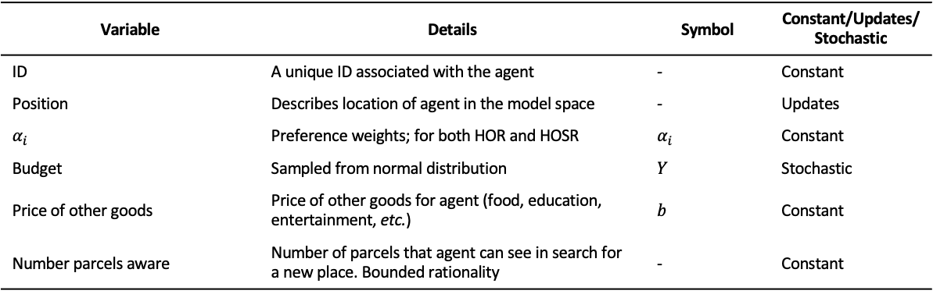
Company Agent
Agent associated with High Occupancy Residential (HOR), High Occupancy Seasonal Rental (HOSR), and Commercial
Similar to Landlord agent
Model attempts to maintain a constant number of company agents searching for unoccupied parcels to buy
Commercial parcels are static in the model (don’t update/change)
Decides whether parcel is on market as HOR or HOSR
Tries to maximize utility associated with parcel
No switching between HOR and HOSR
High Occupancy Residential (HOR)
Parcel is marked for household agents to occupy
If not specified, assume a maximum number of households can occupy the parcel (e.g., size of apartment complex)
High Occupancy Seasonal Rental (HOSR)
Parcel is marked for visitor agents to occupy
If not specified, assume a maximum number of households can occupy the parcel (e.g., size of hotel)
Agents
Land uses
Unoccupied Owner
Unoccupied
Household
Full time resident
Owned Residential
Rental Residential
Landlord
Low Occupancy Seasonal Rental
Company
High Occupancy Residential
Variable | Details | Symbol | Constant/Updates/Stochastic
ID | A unique ID associated with the agent | - | Constant
Position | Describes location of agent in the model space | - | Updates
$$α_{i}$$ | Preference weights; for both HOR and HOSR | $$α_{i}$$ | Constant
Budget | Sampled from normal distribution | $$Y$$ | Stochastic
Price of other goods | Price of other goods for agent (food, education, entertainment, etc.) | $$b$$ | Constant
Number parcels aware | Number of parcels that agent can see in search for a new place. Bounded rationality | - | Constant
Visitor
High Occupancy Seasonal Rental
Commercial
*Arrows denote agent occupies parcel
**Colors denote agent owns parcel

Slide 14
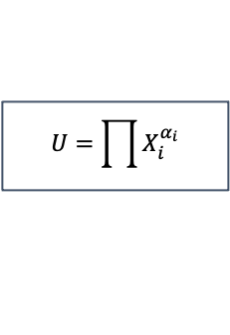
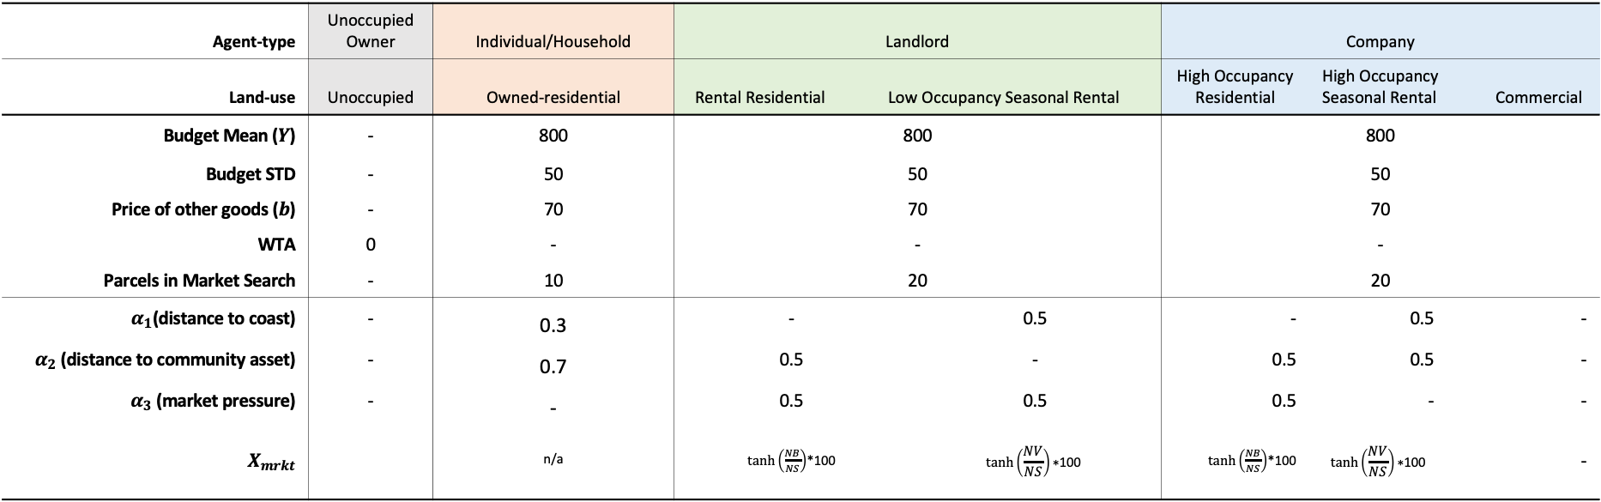
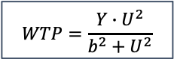
Agent Parameters
Agent-type | Unoccupied Owner | Individual/Household | Landlord |  |  | Company
Land-use | Unoccupied | Owned-residential | Rental Residential | Low Occupancy Seasonal Rental |  | High Occupancy Residential | High Occupancy Seasonal Rental |  | Commercial
Budget Mean ($Y$) | - | 800 | 800 |  |  | 800
Budget STD | - | 50 | 50 | 50 |  | 50
Price of other goods ($b$) | - | 70 | 70 |  |  | 70
WTA | 0 | - | - |  |  | -
Parcels in Market Search | - | 10 | 20 |  |  | 20
$α_{1}$(distance to coast) | - | 0.3 | - | 0.5 | 0.5 | - | 0.5 | -
$α_{2}$ (distance to community asset) | - | 0.7 | 0.5 | - | - | 0.5 | 0.5 | -
$α_{3}$ (market pressure) | - | - | 0.5 | 0.5 | 0.5 | 0.5 | - | -
$$X_{mrkt}$$ |  | n/a | $tanh⁡\left(\frac{NB}{NS}\right)$*100 | $$tanh\left(\frac{D_{sr}}{S_{sr}}\right)∗100$$ | $$tanh⁡\left(\frac{NV}{NS}\right)\text{∗100}$$ | $tanh⁡\left(\frac{NB}{NS}\right)$*100 | $$tanh⁡\left(\frac{NV}{NS}\right)\text{∗100}$$ | -
$$U=\prod{X_{i}^{α_{i}}}$$
Market Scheduling (order of operations in model):
Available parcels are listed on market by owners wanting to sell
Agents not assigned to a parcel search market for parcels that meet preferences
Agents formulate bid and submit to seller of parcel
Sellers evaluate received bids
Transaction and registration of trade
$$WTP=\frac{Y∙U^{2}}{b^{2}+U^{2}}$$

Slide 15
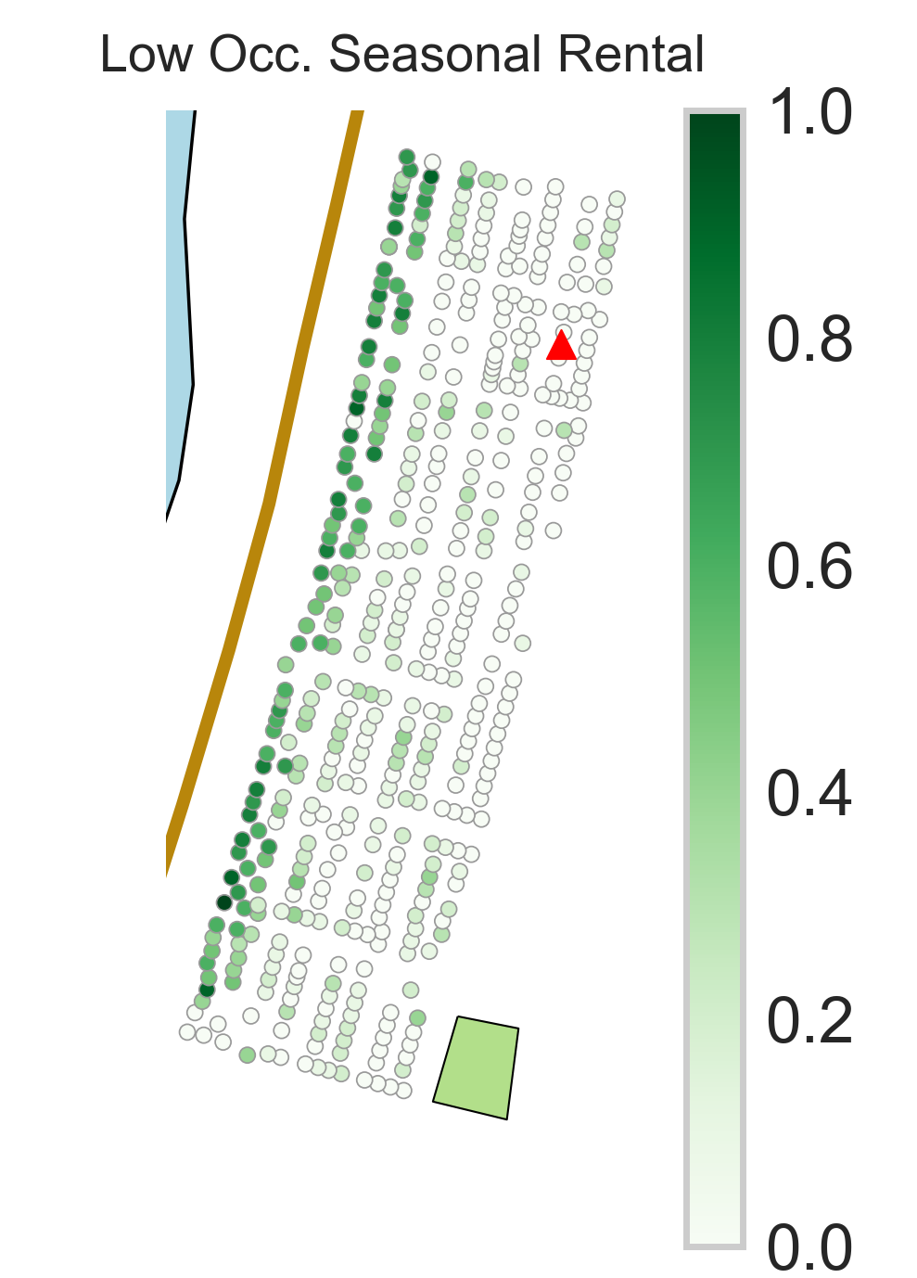
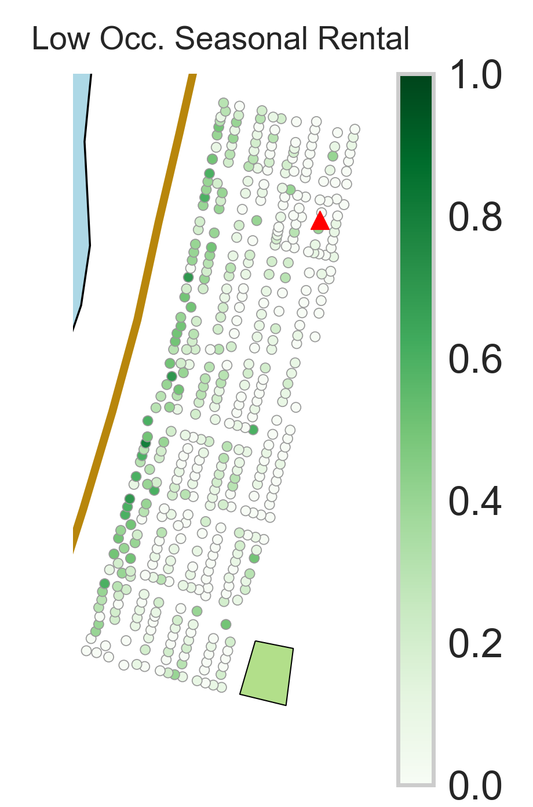
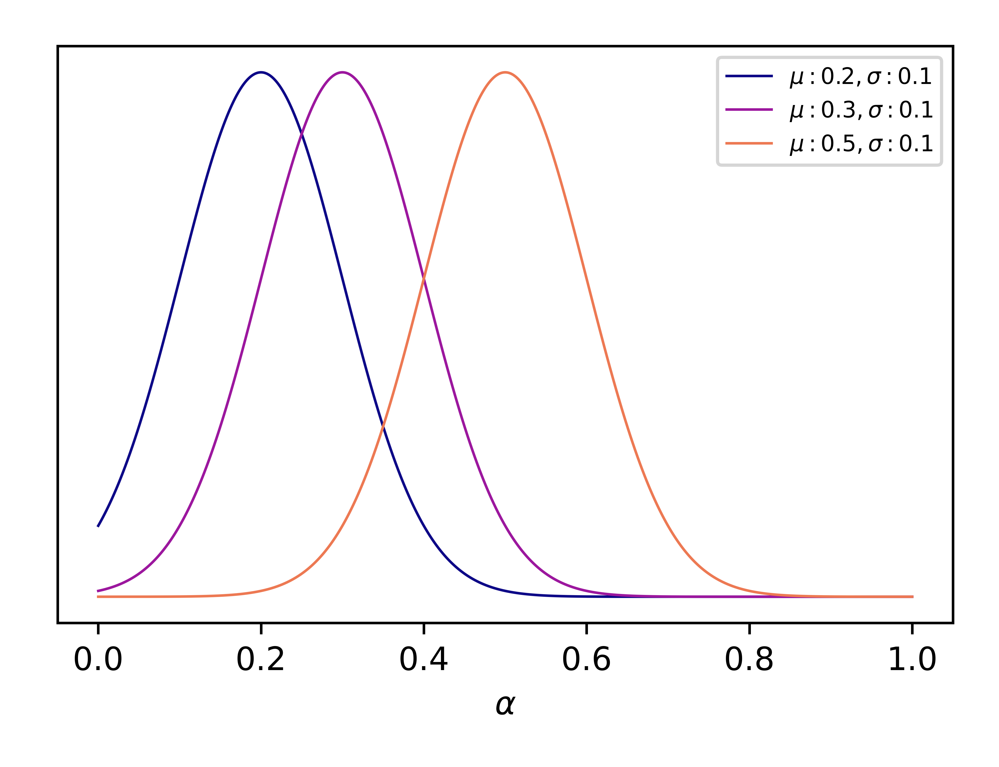
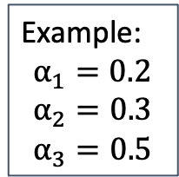
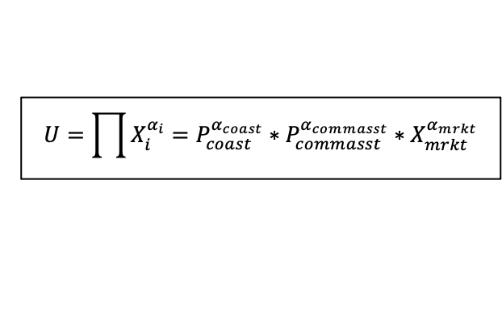
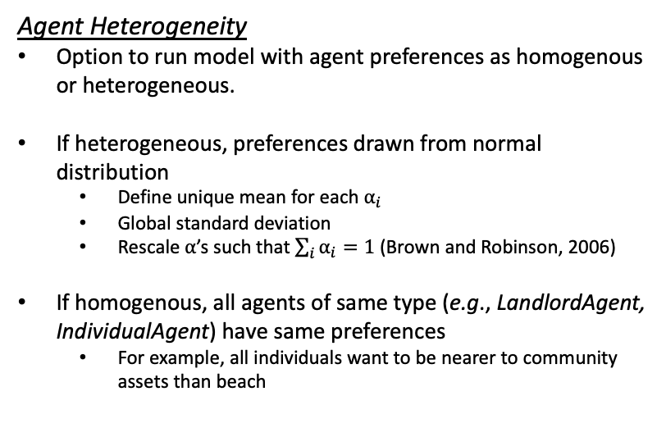
Agent Heterogeneity
Agent Heterogeneity
Option to run model with agent preferences as homogenous or heterogeneous.
If heterogeneous, preferences drawn from normal distribution
Define unique mean for each $α_{i}$
Global standard deviation
Rescale $α$’s such that $\sum_{i}{α_{i}}=1$ (Brown and Robinson, 2006)
If homogenous, all agents of same type (e.g., LandlordAgent, IndividualAgent) have same preferences
For example, all individuals want to be nearer to community assets than beach
Example:
$$α_{1}=0.2$$
$$α_{2}=0.3$$
$$α_{3}=0.5$$
Homogenous
Heterogenous
More variation in model output
$$U=\prod{X_{i}^{α_{i}}}=P_{coast}^{α_{coast}}∗P_{commasst}^{α_{commasst}}∗X_{mrkt}^{α_{mrkt}}$$

Slide 16
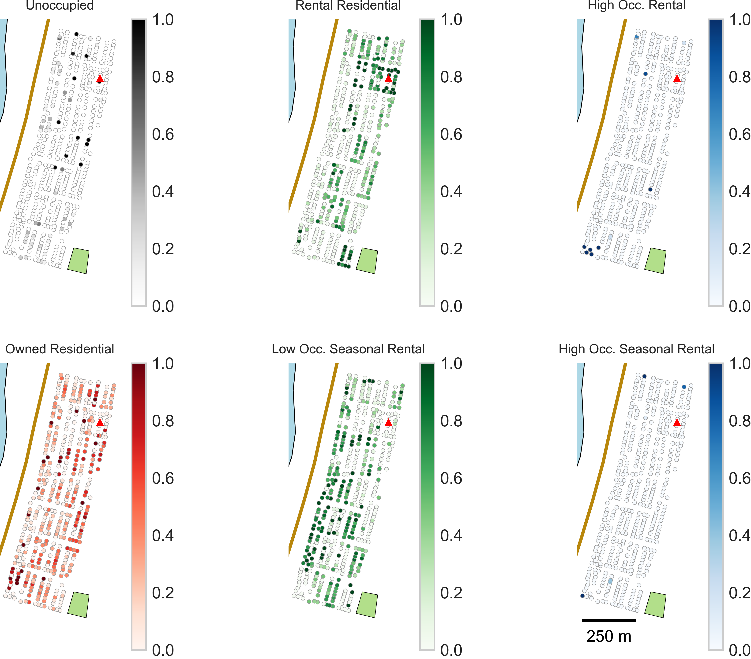
Results - Sub-testbed
Spatial results from 10 iterations
Probability of land use for each parcel
Initial time step (t=0 years)
Uncertainty from housing unit allocation (Rosenheim et al., 2019)

Slide 17
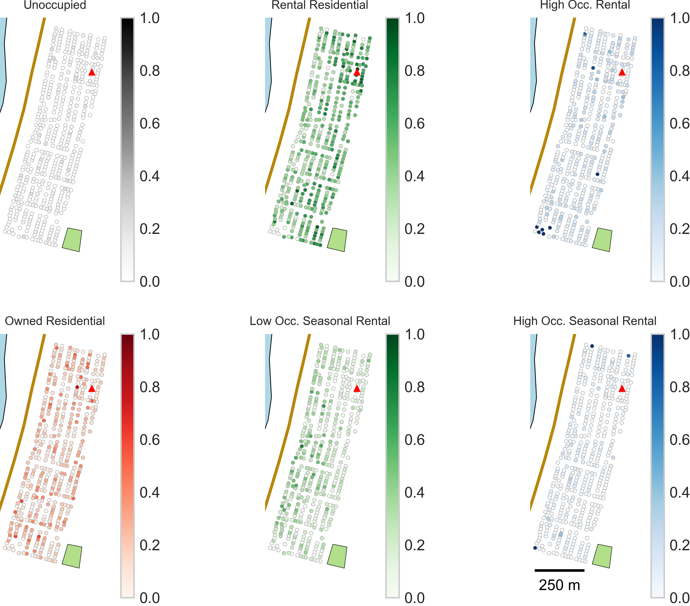
Results - Sub-testbed
Spatial results from 10 iterations
Probability of land use for each parcel
Final time step (t=50 years)
Uncertainty from housing unit allocation (Rosenheim et al., 2019) and market simulation

Slide 18
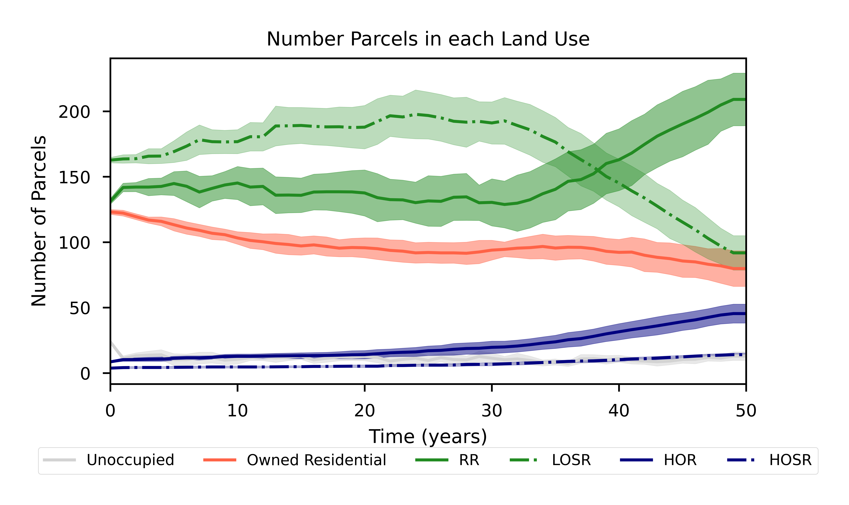
Results - Sub-testbed
Agents
Land uses
Unoccupied Owner
Unoccupied
Household
Full time resident
Owned Residential
Rental Residential
Landlord
Low Occupancy Seasonal Rental
Company
High Occupancy Residential
Visitor
High Occupancy Seasonal Rental
Commercial
*Arrows denote agent occupies parcel
**Colors denote agent owns parcel

Slide 19
Miscellaneous Model Calculations

Slide 20
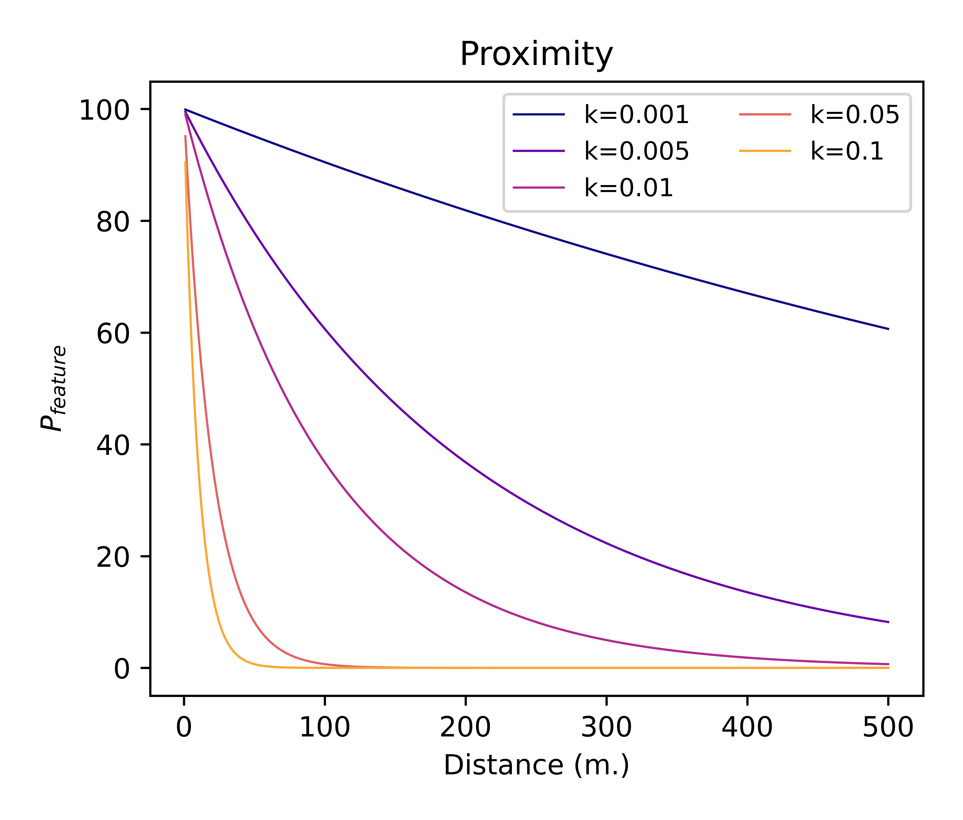
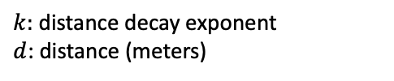
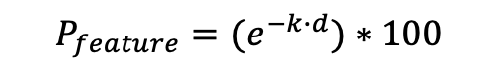
Misc. Model Calculations
Proximity and Distance
Proximity is measured on a scale of 0-100
$$P_{feature}={(e}^{−k∙d})∗100$$
$k:$distance decay exponent
$d$: distance (meters)

Slide 21
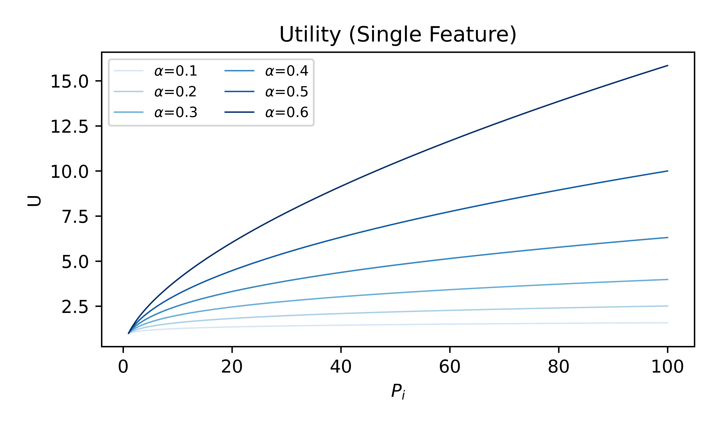







Misc. Model Calculations
Utility Calculations
Cobb-Douglas formulation
Commonly used in urban economics (Huang et al., 2014)
$$U=\prod{X_{i}^{α_{i}}}=P_{coast}^{α_{coast}}∗P_{commasst}^{α_{commasst}}∗X_{mrkt}^{α_{mrkt}}$$
$$U_{preference}$$
$$U_{market}$$
$P_{feature}:$proximity calculations
$X_{mrtk}$: market pressure
$α_{i}$: adds weight to term
Willingness to Pay (WTP)
Function of agent budget, utility, and price of other goods (Filatova, et al., 2011)
$$WTP=\frac{Y∙U^{2}}{b^{2}+U^{2}}$$
$Y:$agent budget
$U$: utility for parcel
$b$: price of other goods

Slide 22
Model and Literature Review

Slide 23
Model Review
Land-use change
General land use change (e.g., forest to deforested)
Urban change and growth
Cellular automata
Agent-based models
Residential choice models
ABM and Natural Hazards
Boundary object (see Guikema paper)
Pre-disaster
Household risk behavior (flood mitigation, seismic retrofits, etc.)
Urban growth/land use change
During:
People locations
Post-disaster (appears to be majority of papers)
Evacuation
Recovery; bouncing back
Insurance

Slide 24

Modeling Review – Summary

Slide 25

Model Review - Land Use Change Detail

Slide 26
References

Slide 27
References
Bruno, B., and Faggini, M. (2020). Sharing Competition: An Agent-Based Model for the Short-Term Accommodations Market. The B.E. Journal of Economic Analysis & Policy, 20(2). https://doi.org/10.1515/bejeap-2019-0231
Filatova, T., Voinov, A., and van der Veen, A. (2011). Land market mechanisms for preservation of space for coastal ecosystems: An agent-based analysis. Environmental Modelling and Software, 26: 179-190. https://doi.org/10.1016/j.envsoft.2010.08.001
Huang, Q., Parker, D., Filatova, T., and Sun, S. (2014). A review of urban residential choice models using agent-based modeling. Environment and Planning B: Planning and Design, 14: 661-689. https://doi.org/10.1068/b120043p
Parker, D., and Filatova, T. (2008). A conceptual design for a bilateral agent-based land market with heterogeneous economic agents. Computers, Environment and Urban Systems, 32. 454-463. https://doi.org/10.1016/j.compenvurbsys.2008.09.012
Parker, D., Brown, D., Filatova, T., Riolo, R., Robinson, D., and Sun, S. (2012). Do land markets matter? A modeling ontology and experimental design to test the effects of land markets for an agent-based model of ex-urban residential land-use change. In Agent-Based Models of Geographical Systems, Edited by Heppenstall, A., Crooks, A., See, L., and Batty, M., 181-197. https://doi.org/10.1007/978-90-481-8927-4_26
Rosenheim, N., Guidotti, R., Gardoni, P., and Peacock, W. (2019). Integration of detailed household and housing unit characteristic data with critical infrastructure for post-hazard resilience modeling. Sustainable and Resilient Infrastructure, 6(6). https://doi.org/10.1080/23789689.2019.1681821
Vinogradov, E., Leick, B., and Kivedal, B. (2020). An agent-based modelling approach to housing market regulations and Airbnb-induced tourism. Tourism Management, 77. https://doi.org/10.1016/j.tourman.2019.104004

